Slide 1
Sports Analytics Hackathon
Hack-A-Shaq

Slide 2
Report Structure
Abstract
Data and Variables
Compound Poisson Process
Monte Carlo Simulation
Summary

Slide 3
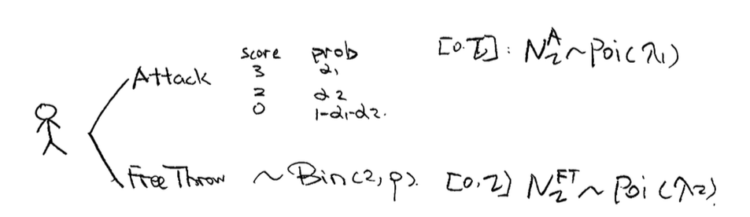
Hack-A-Shaq
Attack or Free Throw:
In time[0,τ] before end of game:
Define the Compound Poisson Process
# Attack~ Poisson(λ₁);
Score{3,2,0} With Probability={α₁, α₂,1-α₁-α₂}
# Free Throw~ Poisson(λ₂);
Score ~ Binomial (2, p)

Slide 4
Hack-a-Shaq with Compound Poisson Process
Scenario One:
# Attack~ Poisson(λ₁);
Score{3,2,0} With Probability={α₁, α₂,1-α₁-α₂}
Expectation: λ₁*τ*(3*α₁+2*α₂)
Variance: : λ₁*τ*(9*α₁+4*α₂)

Slide 5
Hack-a-Shaq with Compound Poisson Process
Scenario Two:
# Free Throw~ Poisson(λ₂);
Score ~ Binomial (2, p)
Expectation: λ₂*τ*(2*p)
Variance: : λ₂*τ*(2*p*q)

Slide 6
Monte Carlo Simulation
% Q2Q3
% Monte Carlo Simulation
% Setting Parameters
lambda1=1;
lambda2=1;
alpha1=0.2;
alpha2=0.3;
p=0.5;
% Setting number of loop to be Ten Thousand
NMCin=10000;
% Initialize Vector
AttackDist=zeros(NMCout,1);
FreeThrowDist=zeros(NMCout,1);
Attack=zeros(NMCin,1);
FreeThrow=zeros(NMCin,1);
Notes:
% Q2Q3
% Monte Carlo Simulation
lambda1=1;
lambda2=1;
alpha1=0.3;
alpha2=0.4;
p=0.5;
NMCout=500;
NMCin=10000;
AttackDist=zeros(NMCout,1);
FreeThrowDist=zeros(NMCout,1);
Attack=zeros(NMCin,1);
FreeThrow=zeros(NMCin,1);
for k = 1:NMCout
for it = 1:NMCin
N1 = poissrnd(lambda1);
N2 = poissrnd(lambda2);
X1 = zeros(N1,1);
X2 = zeros(N2,1);
for i = 1:N2
tempx = binornd(2,p);
X2(i,1)=tempx;
end
for j = 1:N1
tempu=rand;
if tempu<alpha1
X1(j,1)=3;
elseif tempu<(alpha1+alpha2)&&tempu>alpha1
X1(j,1)=2;
else
X1(j,1)=0;
end
end
Attack(it,1)=sum(X1);
FreeThrow(it,1)=sum(X2);
end
AttackDist(k,1)=mean(Attack);
FreeThrowDist(k,1)=mean(FreeThrow);
end

Slide 7
MC Simulation _ Loops (10000)
for it = 1:NMCin
generate N1
generate N2
for i = 1:N2
generate X2;
end
for j = 1:N1
generate X1;
end
end
% Assign Value to Vector
Attack(it,1)=sum(X1);
FreeThrow(it,1)=sum(X2);
% Visualization of the density
% Using “ksdensity” in Matlab
% or Using “ggplot” in R
Notes:
% Q2Q3
% Monte Carlo Simulation
lambda1=1;
lambda2=1;
alpha1=0.3;
alpha2=0.4;
p=0.5;
NMCout=500;
NMCin=10000;
AttackDist=zeros(NMCout,1);
FreeThrowDist=zeros(NMCout,1);
Attack=zeros(NMCin,1);
FreeThrow=zeros(NMCin,1);
for k = 1:NMCout
for it = 1:NMCin
N1 = poissrnd(lambda1);
N2 = poissrnd(lambda2);
X1 = zeros(N1,1);
X2 = zeros(N2,1);
for i = 1:N2
tempx = binornd(2,p);
X2(i,1)=tempx;
end
for j = 1:N1
tempu=rand;
if tempu<alpha1
X1(j,1)=3;
elseif tempu<(alpha1+alpha2)&&tempu>alpha1
X1(j,1)=2;
else
X1(j,1)=0;
end
end
Attack(it,1)=sum(X1);
FreeThrow(it,1)=sum(X2);
end
AttackDist(k,1)=mean(Attack);
FreeThrowDist(k,1)=mean(FreeThrow);
end

Slide 8
Case 1: λ1>λ2; E[X1]≈E[X2]
Parameter
p=0.696
α₁=0.179
α₂=0.509
λ₁=0.4305
λ₂=0.1778
Notes:
Equal Chance in the unit time window to attack and to freethrow.
Eg: Tim Duncan:
http://www.basketball-reference.com/players/d/duncati01.html

Slide 9
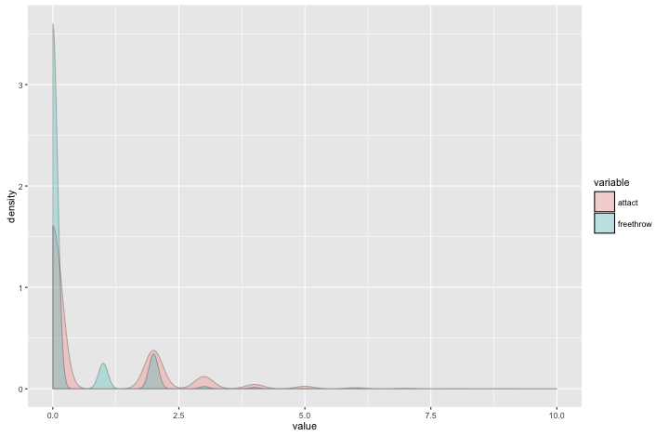
Case 1: λ1>λ2; E[X1]≈E[X2]
Notes:
In terms of the mean, Don’t interrupt the game with assaults.
But it also has a fatter right tail.

Slide 10
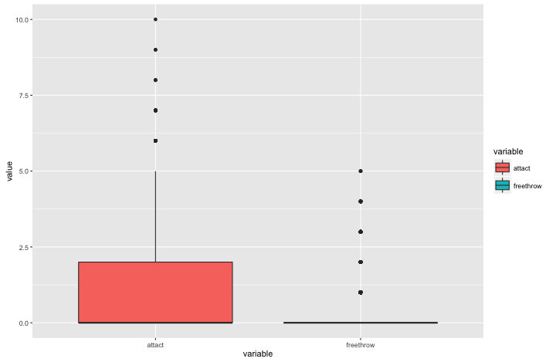
Case 1: λ1>λ2; E[X1]≈E[X2]
Notes:
In terms of the mean, Don’t interrupt the game with assaults.
But it also has a fatter right tail.

Slide 11
Case 2: Shaquille O‘Neal λ1>>λ2, E[X1] ≈ E[X2]
Parameter estimated for O’Neal^{[1]}
p=0.5275
α₁=0.045
α₂=0.5829
λ₁=0.4639
λ₂=0.1417
λ₁>>λ₂
E[X1]≈E[X2]
Notes:
Reference:
[1] http://www.basketball-reference.com/players/o/onealsh01.html
Lambda1=16.7/36
Lambda2 =5.1/36
If a person is able to organize multiple attempts to attack in a very short time, Yes, Definitely assault him as much as possible.

Slide 12
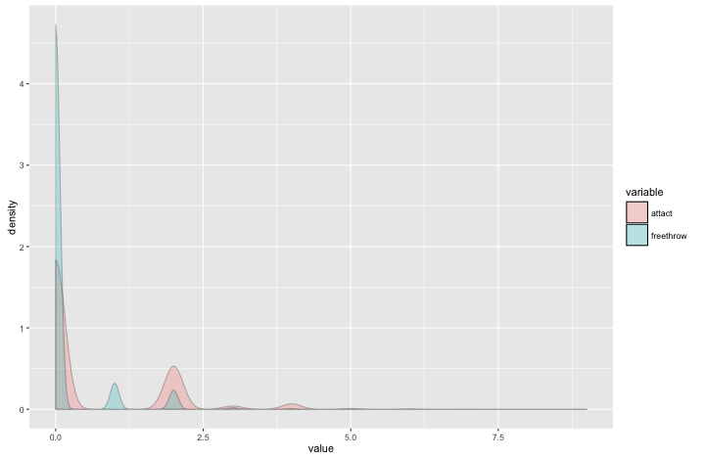
Case 2: λ1>>λ2, E[X1] ≈ E[X2]
Notes:
If a person is able to organize multiple attempts to attack in a very short time, Yes, Definitely assault him as much as possible.

Slide 13
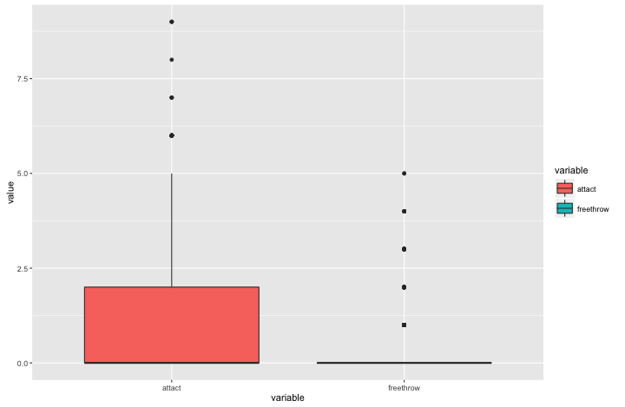
Case 2: λ1>>λ2, E[X1] ≈ E[X2]
Notes:
If a person is able to organize multiple attempts to attack in a very short time, Yes, Definitely assault him as much as possible.

Slide 14
Case 3: λ1>λ2; E[X1]>>E[X2]
Parameter estimated for Case 3
p=0.38
α₁=0.25
α₂=0.554
λ₁=0.3472
λ₂=0.1583
Notes:
Mentally unstable players who is more likely to break under pressure and underperform in the Free Throw:
Andre Drummond
http://www.basketball-reference.com/players/d/drumman01.html
Current worst in terms of Free Throwing rate

Slide 15
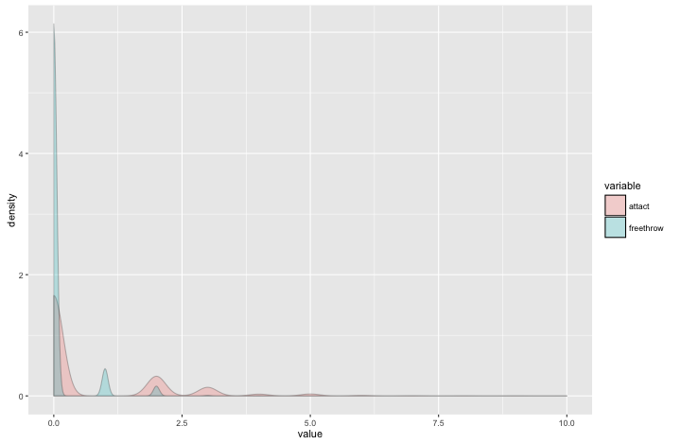
Case 3: λ1>λ2; E[X1]>>E[X2]
Notes:
Mentally unstable players who is more likely to break under pressure and underperform in the Free Throw:
Interrupt them and assault them as frequently as possible and they will break easily.

Slide 16
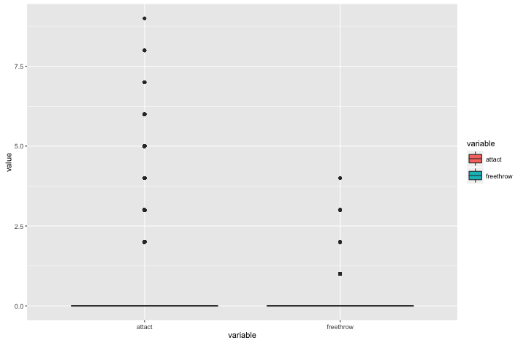
Case 3: λ1>λ2; E[X1]>>E[X2]
Notes:
Mentally unstable players who is more likely to break under pressure and underperform in the Free Throw:
Interrupt them and assault them as frequently as possible and they will break easily.

Slide 17
Case 4: λ1>λ2; E[X2]>>E[X1]
Parameter estimated for Case 3
p=0.893
α₁=0.138
α₂=0.484
λ₁=0.4916
λ₂=0.125
Notes:
Players with a mediocre performance in regular yet a shocking accuracy and stability in free-throwing. Don’t give them the chance to Free Throw.
Calvin Murphy
http://www.basketball-reference.com/players/m/murphca01.html
Current best in terms of Free Throwing Rate

Slide 18

Case 4: λ1>λ2; E[X2]>>E[X1]

Slide 19

Case 4: λ1>λ2; E[X2]>>E[X1]

Slide 20
Summary: Hack-a-Shaq Strategy
Interrupt
Organize attack quickly
Not Interrupt
Stable and even better under pressure
Doesn’t Matter
Unstable under pressure
Lack accuracy
General cases

Slide 21
Summary: Hack-a-Shaq_Example
Interrupt
Shaquille O’Neal
Not Interrupt
Calvin Murphy
Doesn’t Matter
Tim Duncan
Andre Drummond

Slide 22




